Slide 1
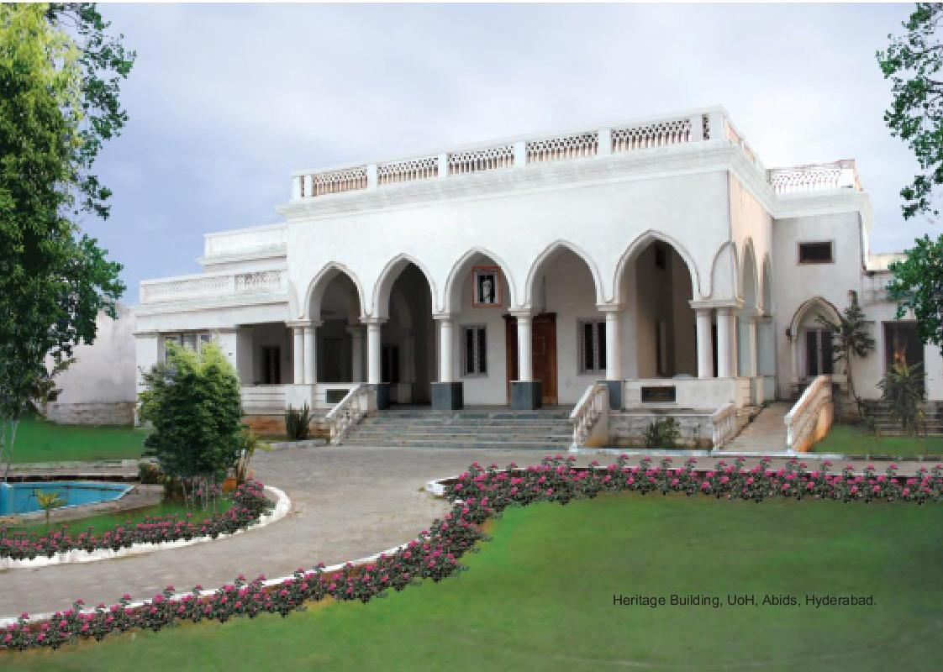
CENTRE FOR DISTANCE AND VIRTUAL LEARNING
WELCOME TO THE 65th CDVL MEETING

Slide 2
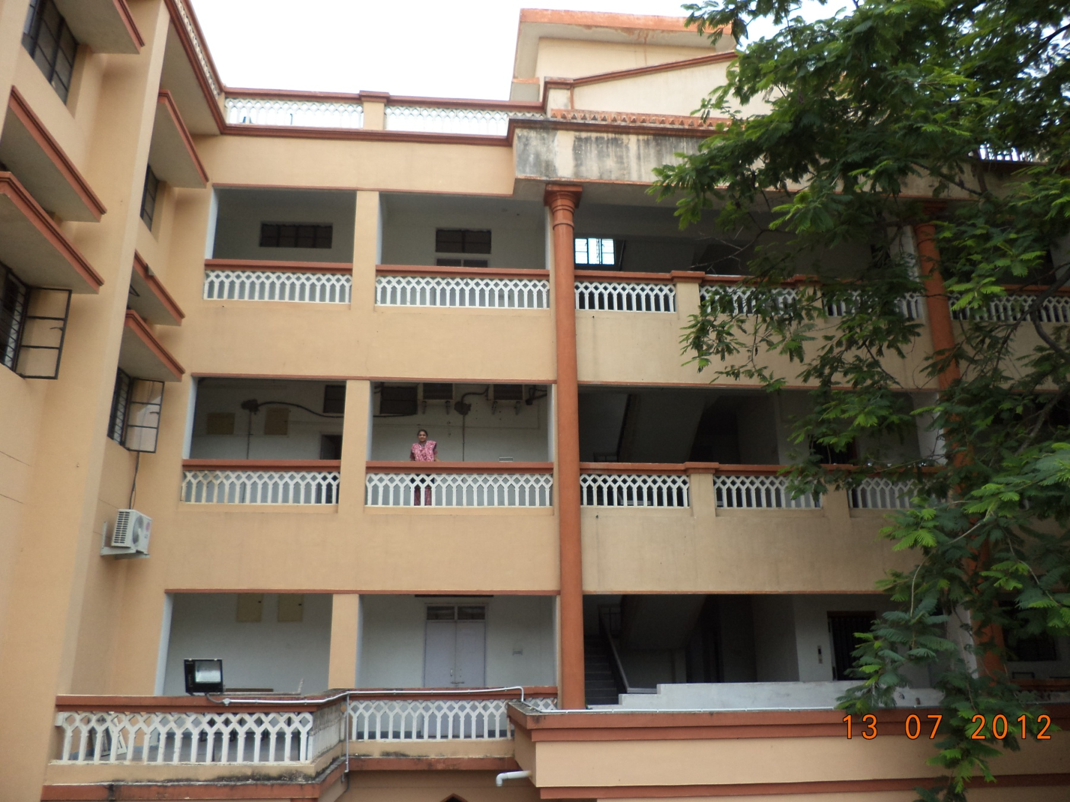
CENTRE FOR DISTANCE AND VIRTUAL LEARNING

Slide 3
Distance & Online Education
Distance education or distance learning is “ a process to create and provide access to learning when the source of information and the learners are separated by time and distance, or both.”
1) National Open University
2) State Open University
3) Dual Mode University
4) Stand Alone Institutions

Slide 4
The Need for Distance Education
1. Equal opportunities to education irrespective of socio economic status
2. Reduces Infrastructure constraints
3. Acts as catalysts for the Institutional transformation
4. Helps the physically challenged individuals
5. Contributes to lifelong learning
6. Helps increase the HE enrolment (GER)

Slide 5
Need for Distance Education in India
NUMBER OF UNIVERSITIES 1260
NUMBER OF COLLEGES 49000
ENROLMENT (GER) 28. 4%
GLOBAL AVERAGE (GER) 36%
DEVELOPED NATIONS >50%
NKC commission recommended to have 1500 HEIs

Slide 6
Higher Education in Developed countries
Sl.No | Name of The Country | Population (in Crores) | No Of Higher Education Universities | % of Students Enrolment
1 | Japan | 12.7 | 804.4 | 56%
2 | U.S.A | 32.6 | 3364 | 70%
3 | U.K | 6.58 | 164 231(Auton) | 52%
4 | Germany | 8.2 | 380 | 62%
5 | INDIA | >100 | 1060 | 28.4

Slide 7
STUDENTS EXPECTATIONS
What are the Expectations from the students
In A.P & TS more than 800 engineering colleges, and nearly 3 lakhs engg. Seats available. Half the seats are going vacant
Students expects two things…….
PLACEMENT & EARN WHILE YOU LEARN

Slide 8
History of Distance Education
Kothari commission on correspondence courses – 1961
ODL in India first started by Delhi University-The school of correspondence courses – 1962
Punjab University – 1968
Meerut and Mysore University – 1969
Dr. B.R.Ambedkar Open University – 1982
IGNOU – 1985
Total Open Universities – 14
Total UGC recognized CDEs - 87

Slide 9
TEACHING & LEARNING METHODOLOGIES (IoT)
With regard to the Internet of things, (IOT) this is an object of the physical world (physical things) or the information world (virtual things), which is capable of being identified and integrated into communication networks.

Slide 10
AI - METAVERSE
It is a Virtual reality space in which the users can interact with a computer generated environment and other users
The Multiverse is a highly random and contain different virtual worlds

Slide 11
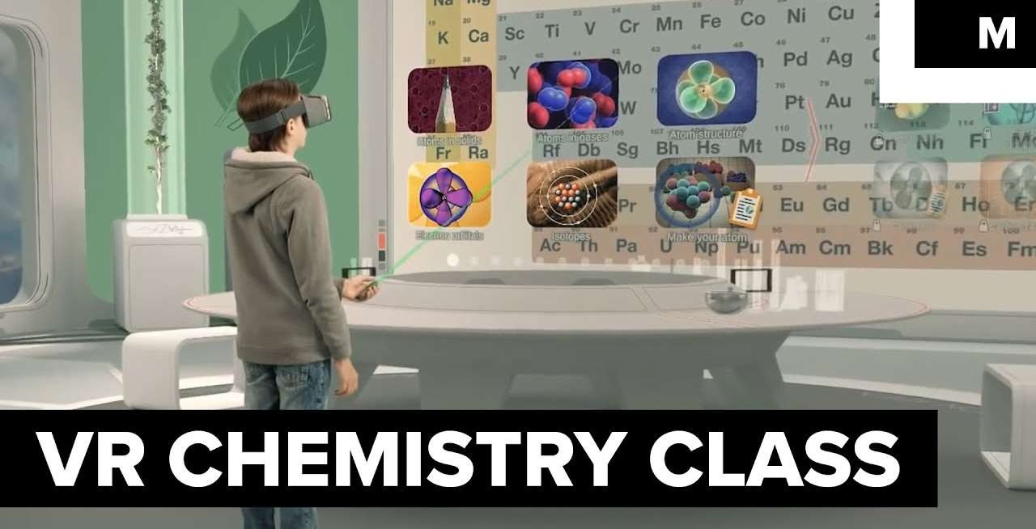

25/10/2017

Slide 12
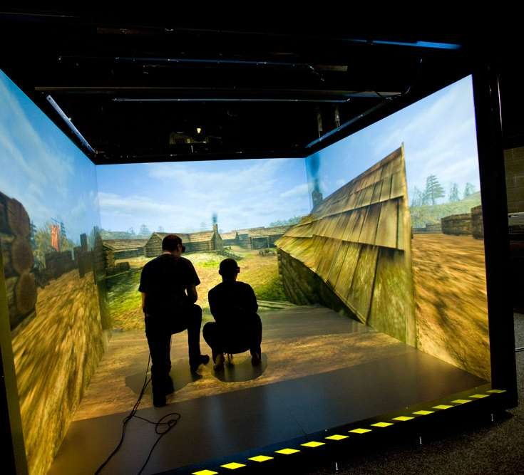
Types of VR technologies
Immersive room / cave
It is a small surround- screen projection space in which audio and visual media are projected in order to present users with a walk-in feeling, as if they are in a certain geographical or historical space.

Slide 13
REGULATORY CHALLENGES IN DUAL MODE HEIs
UGC Regulations for ODL 2017
UGC Regulations for Online courses 2018
UGC Regulations for ODL and Online 2020
AICTE Regulations for ODL and online 2021
Accreditation guidelines
NCrF guidelines for credits 2023
UGC Guidelines for the introduction of skill-based Courses 2025…
UGC-Draft Guidelines for Recognition of Prior Learning (RPL)-2025

Slide 14
Amendment of UGC regulation
UGC released amendments after the UGC regulation
Stand along institution can not offer distance education programme unless they are converted as deemed university
NAAC accreditation should be minimum 3.01 grades up of 4 scale DUAL mode can offer distance education programme and 3.26 grade for offering online programmes.
Open university exempted from NAAC accreditation till they get the same.
IGNOU exempted from regulations to offer ODL & Online Programme

Slide 15
Academic Bank of Credits
Academic Bank of Credits shall have a dynamic website providing all details andshall provide a variety of services
Every student the facility to open unique or individual Academic Bank Account in digital form;
Courses undergone by the students through the online modes through National Schemes like SWAYAM, NPTEL, V-Lab etc. or of any specified university, shall also be considered for credit transfer

Slide 16
ABC contd.
Provided that, the student shall be required to earn at least fifty per cent of the credits from the Higher Education Institution awarding the degree or diploma or certificate:
Credits earned by students shall be deposited in the respective Academic Bank Account with ABC and shall be valid for not exceeding seven years
  Once used, or redeemed, Credits earned by a student cannot be re-used for the award of any other formal academic qualifications.

Slide 17
NUMBER OF CREDITS
One credit is equal to 15 hours of face to face teaching
30 hours of learning inputs though SLM, assignments, seminars, discussion etc
40 credits equal to 40 X 30= 1200 hrs learning
inputs i.e 20 X 30 = 600 hours per semester

Slide 18
NHEQF levels | Qualification title/nomen clatu re | Credit Requirements
Level 5 | Undergraduate Certificate one year or 2 semesters | 40 credits
Level 6 | Undergraduate Diploma two years (4 semesters) | 80 credits
Level 7 | Bachelor’s Degree duration: Three years or 6 sems | 120 credits
Level 7 | Bachelors of Vocation (B.Voc ). 3 years or 6 sems | 120 credits
Level 7 | B.E Engineering & Technology. : Four years or 8 sems | 160 credits
Level 8 | Bachelor’ s Degree (Honours ) Four years or 8 sems | 160 credits
Level 8 | Post-Graduate Diploma for those who exit after successful completion of the first year or two sems | 40 credits
Level 9 | Master’s degree. (Programme duration: Two years or 4 semesters | 80 credits
Level 10 | Doctoral degree | Credits for course work

Slide 19
For Online mode: e-content
(i) QUADRANT-I is e-Tutorial; which shall contain: Video and Audio Content in an organised form, Animation, Simulations, Video Demonstrations, Virtual Labs, etc.,
(ii) QUADRANT-II is e-Content; which shall contain; self instructional material, e- Books, illustrations, case studies, presentations etc, and also contain Web Resources such as further references, Related Links, Open source Content on Internet, Video, Case Studies, books including e-books, research papers and journals,, etc.
(iii) QUADRANT-III is the Discussion forum for raising of doubts and clarifying them on a near real time basis by the Course Coordinator or his team.
(iv) QUADRANT-IV is Assessment, which shall contain; Problems and Solutions, which could be in the form of Multiple Choice Questions, Fill in the blanks, Matching Questions, Short Answer Questions, Long Answer Questions, Quizzes, Assignments and solutions,

Slide 20
Guidelines for the introduction of skill-based Courses 2025
An essential component of these guidelines is the collaborative model between academic and industry, which allows HEIs to work closely with industry experts.
This partnerships will enable students to gain real world experience and hands on knowledge.
Micro-Credentials (MCs) aimed at up skilling or re skilling in specialized area through short- term learning modules.

Slide 21
Guidelines for the introduction of skill-based Courses…contd
These guidelines and Standard Operating Procedures (SOPs) supplement the NCrF, guiding institutions and organizations in implementing
Theory: 1 credit = 15 hours
Practical: 1 credit = 30 hours
For courses aligned with the National Skills Qualification Framework (NSQF), 1 credit equals 30 hours of learning, with no distinction between theoretical, practical or experiential learning.

Slide 22
UGC-Draft Guidelines for Recognition of Prior Learning (RPL)-2025
RPL is a formal mechanism used to evaluate a person’s existing knowledge, skills, and experience gained through formal and non-formal, or informal learnings.
RPL is already existing in the countries like Australia, South Africa, New Zealand, Canada, USA, Malaysia, Ireland and European countries.
Individuals working in industry could greatly benefit from earning credits for similar activities. These credits could then be used to pursue higher education programs (Bachelor's, Master's, Doctoral, Post-Doctoral, etc.)

Slide 23
UGC Draft Guidelines for Recognition of Prior Learning 2025
Example Use Case:
Asha, a nurse with a Diploma in General Nursing and Midwifery (GNM), seeks to upgrade her qualifications to a Bachelor of Science in Nursing (B.Sc Nursing)
Submission of Documentation: Asha submits her GNM diploma, detailed transcripts, course descriptions, and a letter from her employer mentioning her roles, responsibilities, and professional competencies developed during her three years of experience in a large hospital.

Slide 24
UGC Draft Guidelines for Recognition of Prior Learning….Contd
Assessment Process: An assessment body, in collaboration with an awarding body in the nursing sector, evaluates Asha's educational background and professional experience. They compare the curriculum of her GNM program with the courses offered in the B.Sc. Nursing program.
Credit Awarding through RPL: Based on the assessments, the assessment body determines the equivalence of Asha's GNM curriculum with the B.Sc. Nursing program.

Slide 25
UGC Draft Guidelines for Recognition of Prior Learning…contd
Non-formal learning Examples include:
Workshops
Short Courses
Professional Development Programs
Community Education
Self-Study
Online Courses and Webinars
Company Training Programs
Arts and Sports Training
Youth Groups
Scout Programs

Slide 26
Selected Online learning portals for students and teachers:
S NO | Portals | Content Details
1 | Bharat Skills https://bharatskills.gov.in/ | The Bharat skills portal has videos available for 79 trades like carpenter, electrician, plumber, etc.
2 | e-SkillIndia https://eskillindia.org/ | It is a multilingual portal offers more than 400 courses in about 10 regional languages.
3 | NASSCOM-Future Skills http://futureskills.nasscom.in/ | NASSCOM Future skills portal is a portal where students can learn the skills of the future
4 | Skills build http://skillsbuild.org/ | It provides courses in the latest technology like Artificial intelligence, Cyber security, Client etc.
5 | TCS ion Digital Learning https://www.tcsion.com/LX/login#lx | TCS ion is a digital portal that offers a number of courses spread across various fields with NSDC and NCS, for virtual training and job
6 | SWAYAM https://swayam.gov.in/ | It has courses from class nine to post-graduation. Courses.
7 | NPTEL https://nptel.ac.in/ | NPTEL portal is coordinated majorly by IIT Madras along with other IITs.

Slide 27
Selected Online learning portals for students and teachers:
8 | National Digital Library: | It is a digital repository of vast amount of academic content different Indian languages
9 | CEC -UGC YouTube portal | Provide access to unlimited educational curriculum based lectures absolutely free.
10 | Swayam Prabha https://www.swayamprabha.gov.in/ | SWAYAM PRABHA is a group of 32 DTS channels, provided by NPTEL, IITs, UGC, CEC, IGNOU, NCERT, etc.
11 | E-PG Patashala https://epathshala.nic.in/index.php?In=en | E-PG Patashala is an high quality, which is a storehouse of audios, videos, flipbooks, etc. available in Hindi, English, and Urdu.
12 | Diksha https://diksha.gov.in/ | National Teacher Platform is built to host Open Educational Resources (OER) and tools for Teachers
13 | E-shodh Sindhu | It provides current access to more than 6000 e- journals and more than 6 lakh e-books in different disciplines.
14 | Shodh Ganga: | It is a digital repository platforms of 2, 80,000 research thesis and dissertations for research students

Slide 28
CDVL PROGRAMMES
The Centre initially started with two diploma, programmes. Presently it is offering Sixteen One year Diploma Programmes, which are employable knowledge oriented and skill upgrading programmes.
Most of the students are working employees from various state and central government offices, few are IAS and IPS Officers, lawyers, magistrates; and also housewives.
These distance programmes are also approved by the UGC-AICTE-DEC joint committee.
In order to maintain the standards in the quality of teaching in distance courses, the regular faculty from the university have put their best efforts in designing the courses, framing the syllabus, development of Self learning material and conducting the contact classes, examination and evaluation process.
Since these programs are skill upgrading and employable programmes Virtual learning coupled with Hands and training is being used in the teaching learning process.

Slide 29
UNIQUE FEATURES OF CDVL- UOH
All courses are Knowledge and skill up gradation add on Programmes
Courses are designed by the teaching faculty of the regular departments
Practical training in the laboratories
Project work (case study) as one of the components
60-80 hrs of compulsory contact/ VIRTUAL classes per term
Self Learning material is well prepared and designed in both soft and hard copy and Virtual Vedios are recorded as per 4 quadrant mode
Continuous evaluation system
Minimum qualifying pass marks is 40%
Conducting Proctored examination under CCTV surveillance

Slide 30
List of Diploma Programmes 2024 - 25
S.No | Programmes | Application Received | No. of. Students Enrolled
1. | Diploma in Library Automation & Networking(DLAN) | 60 | 47
2. | Diploma in Cyber Laws & Intellectual Property Rights (DCL & IPR) | 51 | 23
3. | Diploma in Criminal Justice & Forensic Science (DCJ & FS) | 51 | 29
4. | Diploma in Business Management (DBM) | 50 | 24
5. | Diploma in Project Management (DPM) | 62 | 32
6. | Diploma in Infection Prevention and Control (DIPC) | 70 | 60
7. | Diploma in Community Eye Health (DCEH) | 50 | 14
8. | Diploma in Communicative English (DCE) | 78 | 66
9. | Diploma in Governance (DG) | 50 | 30
10. | Diploma in Energy Management | 50 | 18
11. | Diploma in Artificial Intelligence & Machine Learning (DAI & ML) | 110 | 79
12. | Diploma in Panchayat Raj Governance & Rural Development (DPRG & RD) | 54 | 20
13. | Certificate(Birth Care Practitioner (Birth Doula) Certificate Course) ( BCPCC) 6 Months Course | 18 | 17
Total |  | 754 | 462

Slide 31
Faculty cum Coordinators
1 | Diploma in Business Management (DBM) | Prof. B. Raja Shekhar
2 | Diploma in Criminal Justice & Forensic Science (DCJ&FS) | Dr. D.Veerababu
3 | Diploma in Cyber Laws & Intellectual Property Rights (DCL&IPR) | Dr. M.Nagamani
4 | Diploma in Library Automation & Networking (DLAN) | Dr.N. Varatharajan
5 | Diploma in Project Management (DPM) | Prof. Mary Jessica
6 | Diploma in Technology Management in Agriculture (DTMA) | Prof. C. Raghava Reddy
7 | Diploma in Community Eye health | Prof. Shamanna
8 | Diploma in Panchayati Raj Governance & Rural Development (DPRG & RD) | Prof. C. Raghava Reddy
9 | Diploma in Governance (DG) | Prof. E.Venkatesh
10 | Diploma in Energy Management | Prof. Chetan Srivastava
11 | Diploma in Artificial Intelligence & Machine Learning (DAI & ML) | Prof. Atul Negi
12 | Diploma in Infection Prevention and Control | Prof. B.R. Shamanna,
13 | Certificate(Birth Care Practitioner (Birth Doula) Certificate Course) ( BCPCC) 6 Months Course | Prof. B.R. Shamanna,

Slide 32
List of Diploma Programmes with Credits
S.No | Course | No .of. Credits for programme
1. | Diploma in Business Management (DBM) | 42-46
2. | Diploma in Project Management (DPM) | 42
3. | Diploma in Library Automation & Networking(DLAN) | 40
4. | Diploma in Cyber Laws & Intellectual Property Rights (DCL & IPR) | 40
5. | Diploma in Criminal Justice & Forensic Science (DCJ & FS) | 40
6. | Diploma in Infection Prevention and Control (DIPC) | 40
7. | Diploma in Community Eye Health (DCEH) | 40
8. | Diploma in Communicative English (DCE) | 40
9. | Diploma in Governance (DG) | 40
10. | Diploma in Energy management (DENM) | 41
11. | Diploma in Artificial Intelligence and Machine Learning (AI&ML) | 40
12. | Diploma in Panchayat Raj Governance & Rural Development (DPRG & RD) | 40
13. | Diploma in Health Care Management (DHCM) | 40
14. | Diploma in Hospital Management (DHM) | 40
15. | Diploma in Education Technology Management (DETM) | 40
16. | Diploma in Technology Management in Agriculture (DTMA) | 40
17. | Diploma in Telecom Technology Management (DTTM) | 40
18. | Advanced Certificate Programme in Critical Care (ACPCC) | 20

Slide 33
QUALITY STANDARDS
Quality Standards:
The CDVL presently offering 15 one year Diploma Programmes which are skill based knowledge up-gradation and employable enhancing programmes.
Many of the successful candidates had got placements in private and public sector organizations because of the compulsory classes, practical training, internship activities.
Recently UGC and NAAC identified CDVL as one of the National
Consultative member to take the inputs from the Centre have been taken for preparing accreditation norms for the assessment of the Open and Dual mode universities.

Slide 34
Digilocker & ABC data-2021- 2023
S.No | Year | Final Certificate Issued | Student Registred ABC – Ids
1 | 2018-2020 | 111 | 04
2 | 2021 | 653 | 218
3 | 2022 | 402 | 182
3 | 2023 | 109 | 23
Total |  | 1275 | 427

Slide 35
Uploading of Data from 2012- 2020 In Digilocker
S.No | Year | No .of Students ( Including Backlog)
1 | 2012 | 501
2 | 2013 | 516
3 | 2014 | 532
4 | 2015 | 470
5 | 2016 | 371
6 | 2017 | 449
7 | 2018 | 387
8 | 2019 | 442
9 | 2020 | 410

Slide 36
STEPS FOR NEW COURSE
Programme committee
Syllabus and self learning material preparation.
School board/ CDVL Board
Academic council
UGC (intimation)

Slide 37
ANNUAL CYCLE
Advertisement for
Admission
Admission letter
Payment of fee
Dispatch Study Material
Assignment from coordinators & spend to study
Assignment of II Term
Filled Assignment Books submission
Evaluation
Contact Classes
Exams
2nd Term of Fees & Book
Application Received
Submission II Term assignment
Contact classes entimation
Contact Classes
Exams
Results
Certificates
Academic Year

Slide 38
WHY JOINT PROGRAMMES
Many ODL institutions are NOT getting admissions to ODL and online programmes in spite of their low fee
Survey conducted Industry want to take the students provided they have required skill
Students are even ready to pay higher fee provided if they get placement support
Thus designed Skill up gradation programs jointly with Industry and Needy sector along with hands on training, project work etc.

Slide 39





Joint Programmes with reputed Institutions
Diplomas in Technology Management in Agriculture and Educational Technology management – NAARM-ICAR-Hyd
Diploma in Telecom Technology Management jointly with BSNL-NATFM
Diploma in Panchayat raj Governance & Rural development. Jointly with NIRD.
Diplomas in Hospital Management and Health care management jointly with Apollo Med skills
Diploma in AI & ML jointly with AAIC Hyd.
Diploma in Infection Prevention and Control jointly with IFCAI
Diploma in Community Eye Health care jointly with LV Prasad Instt
Proposal with L & T Metro Rail , German Academy for jointly offering demand based programs

Slide 40
TARGETS REACHED
Approval from UGC has been received for 15 PG Diploma Programmes and Up-Skilling Programmes offered through distance/ VIRTUAL mode.
Nearly 25000 participants/students were admitted to programmes. As per records of verification
15% people got placement as these courses helped them as on add on courses for their basic degrees.
15% people got incentives and increments in their parent companies.
10% people got further studies in US as the Diploma helped them as (3+1 year degree) to fourth year to their normal degree ( Transcripts verification )
30% people pursued upskilling programs which was helpful in their profession.

Slide 41
THRUST AREAS COVERED
Rural development:
Agricultural technology management:
Health Management
Cyber laws and Intellectual property Rights
Forensic Science:.
Human rights:
Chemical Analysis and Quality Management:
Herbal medicine (AYUSH):
Telecom technology Management:
Library Automation & Networking:
Buisiness Management & Project management:
Energy management:.
Languages promotion (English..Hindi..Telugu…Urdu)
Environment Management

Slide 42
RECOGNITION
All programs are approved by UGC-AICTE-DEB joint committee.
Recognised by World Educational Services (WES) TORONTO and NEWYORK
CDVL centre recognised as one of the National consultative committee Member by NAAC for for taking the inputs in preparation ODL Manual.
VIRTUAL content is with 4 quadrant model as per UGC guidelines

Slide 43
AWARDS / NOMINATIONS
The CDVL programmes are recognised by the UGC-AICTE_DEB joint committee meetings
CDVL Diploma programme were also recognized by World Education Services (WES), New York & Toronto.
Earlier the NAAC had invited CDVL as a National Consultative Committee Member to finalize the NAAC assessment and accreditation manual exclusively for Distance and Open Learning Universities and centres.
In view of the CDVL Innovative and quality standards, it was nominated in the Public HEIs Distance Education internal Committees of Universities like MANUU, EFLU, Mahatma Gandhi Antarrashtriya Hindi Vishwa Vidyalaya,Wardha, National Sanskrit University (NSU, Tirupathi), Dr. B R Ambedkar Open University (DR.BRAOU, Hyderabad) and Kakatiya University , Warangal, Andhra University,
CDVL director was also nominated Advisory Board of private universities like symbiosis Hyderabad & ICFAI University Hyderabad.

Slide 44
PROPOSED ACADEMIC PROGRAMMES UNDER (NEP):
Faculty | Proposed programme
Electronics | Short duration programme jointly with L&T Metro Rail Short duration programme jointly with GERMAN ACADEMY OF DIGITAL EDUCATION (DADB)
Life Sciences | Diploma in Plant Health Management jointly with NIPHM M.Sc in Embryology
PG Programmes | MBA in Hospital Management M.Sc. In Embryology School of Life Sciences

Slide 45
FUTURE PROGRAMMES
PROVIDING PAID APPRENTISHIP
TO THE CDVL STUDENTS
FROM THE DATE OF ADMISSION

Slide 46
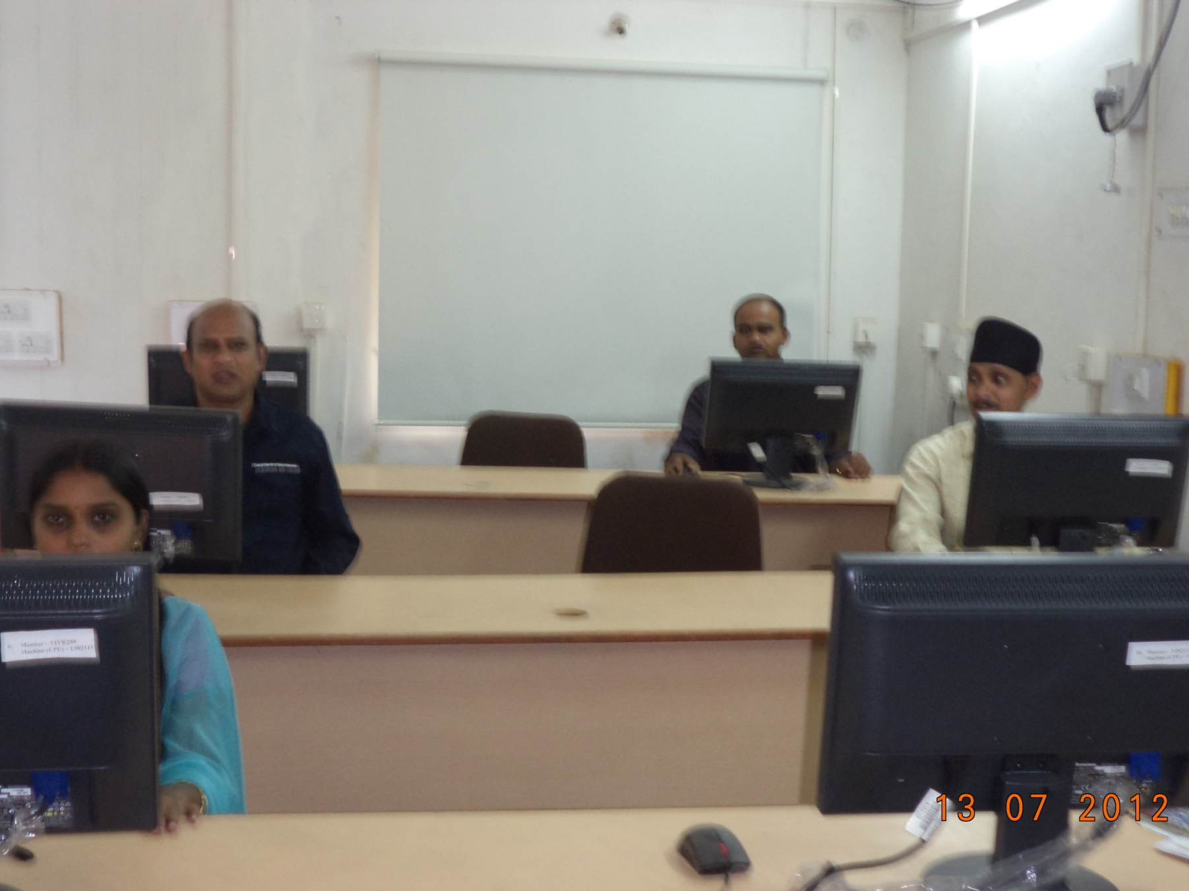
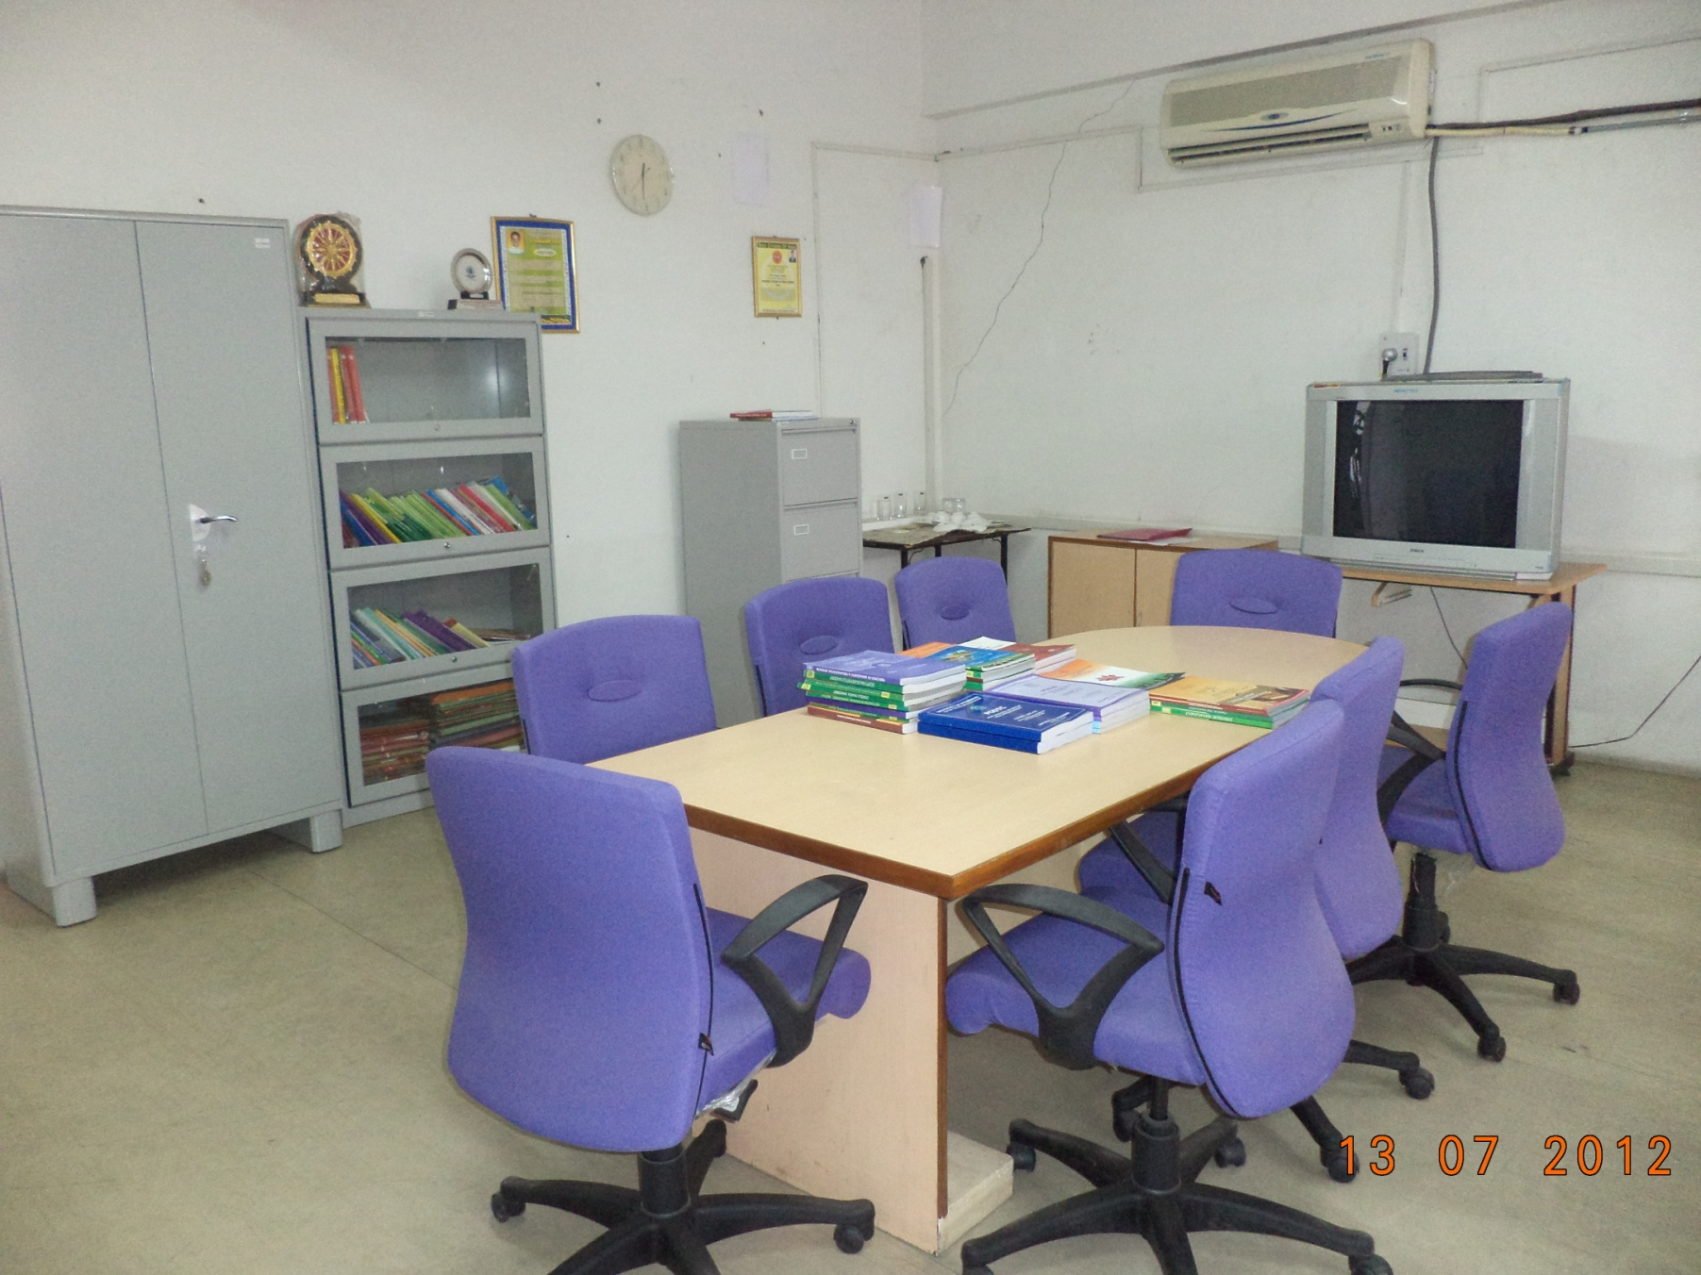
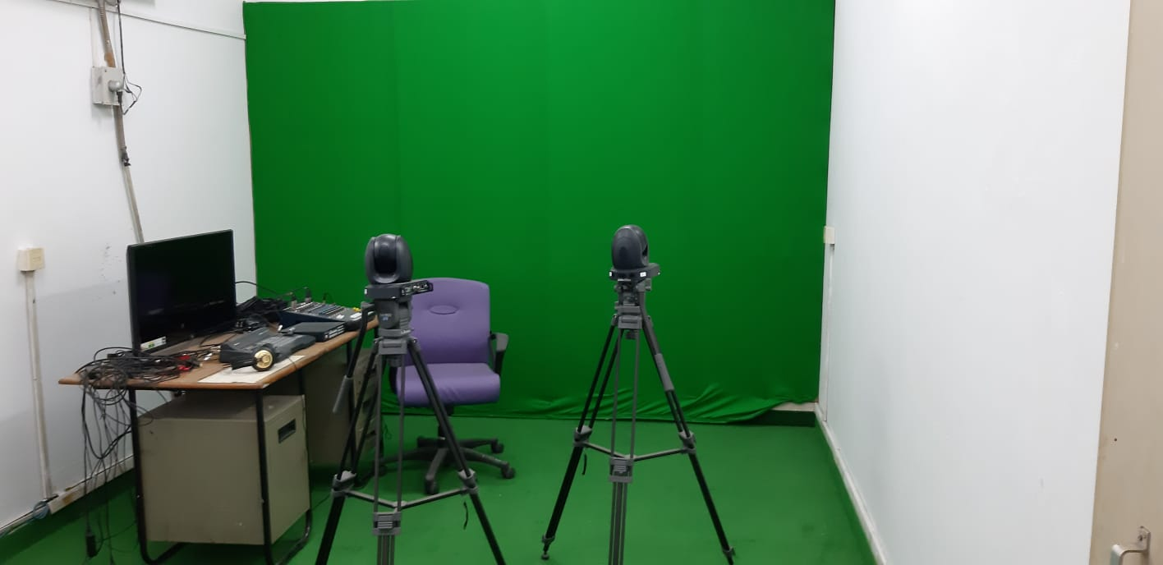
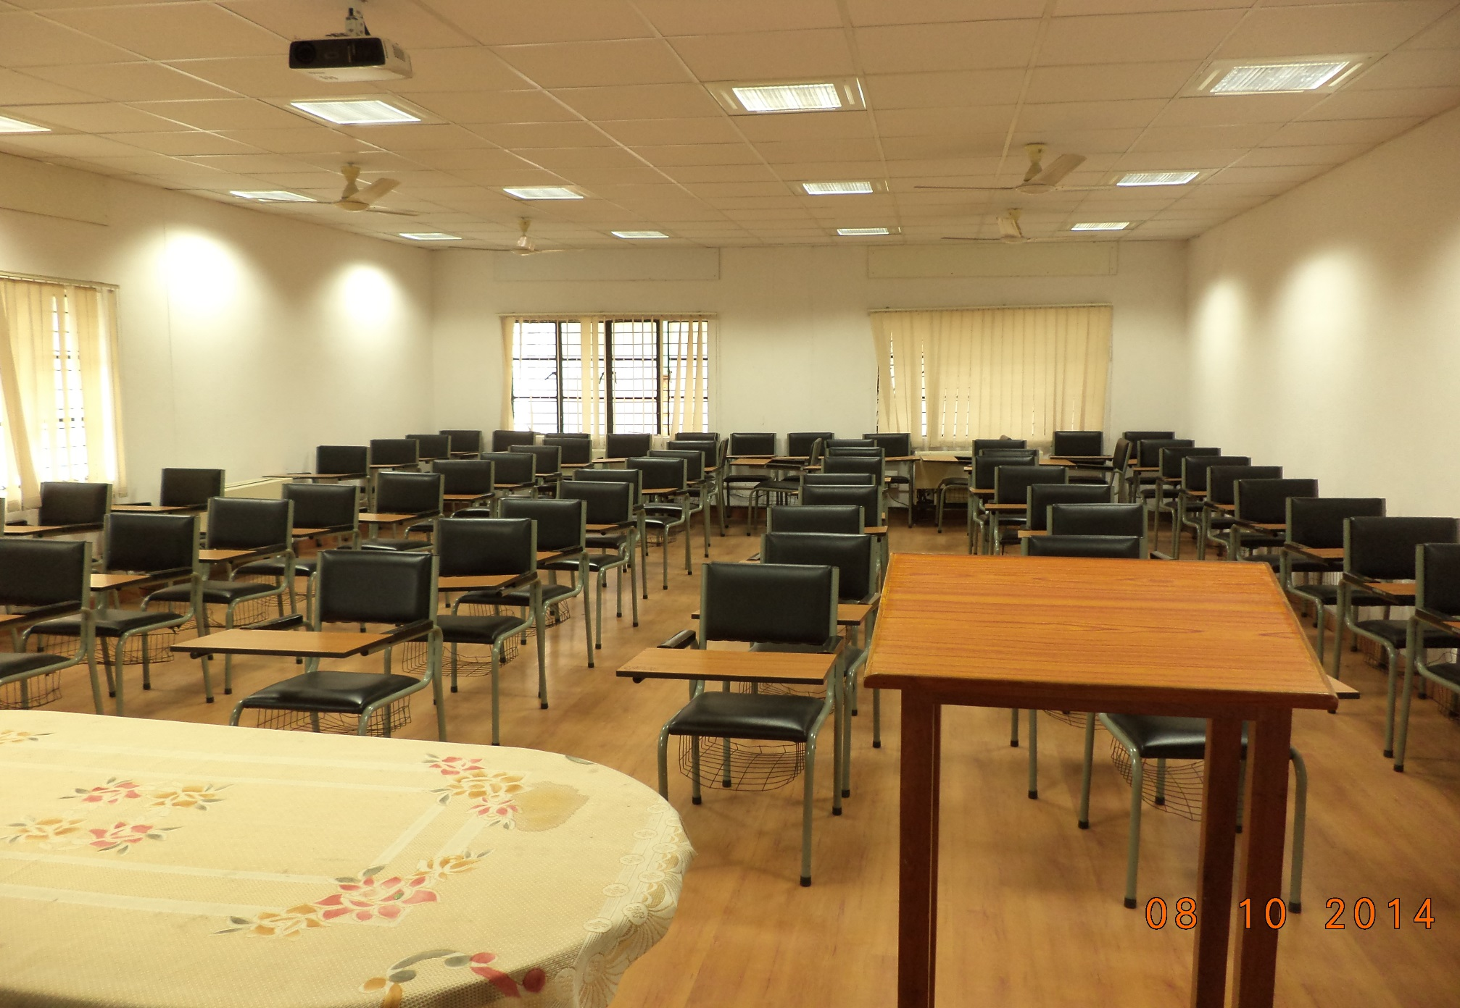
CDVL INFRASTRUCTURE
Exclusive facilities at GT
Computer Lab
Library
Virtual Recording Lab
Digital Class room with Digital smart Boards
NEW Seminar Hall
Entire 3 Acre campus is under CCTV survive lance

Slide 47
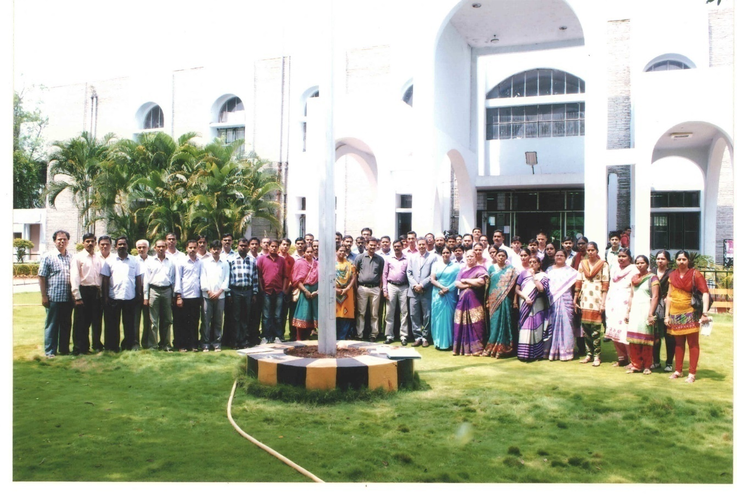
SEMINARS/ COFERENCES
Conducted International Conference on ICT based Teaching and Learning 2017 inviting COL President Prof Asha Kunwar, President COL, Vancouver
Research proposal submitted to AYUSH based on our PGD Medicinal Botany programme
Conducted seminars/ workshops jointly with NIRD, IFCAI, Apollo Meds skills

Slide 48
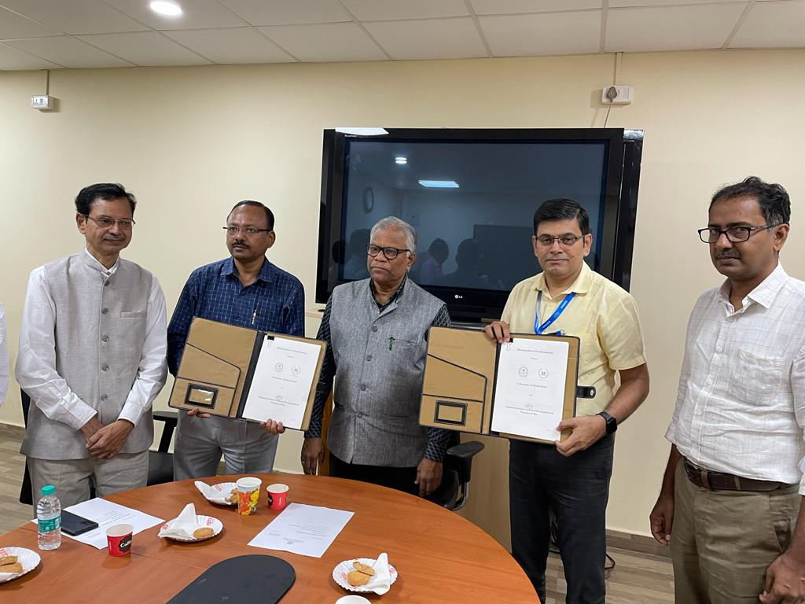

Slide 49
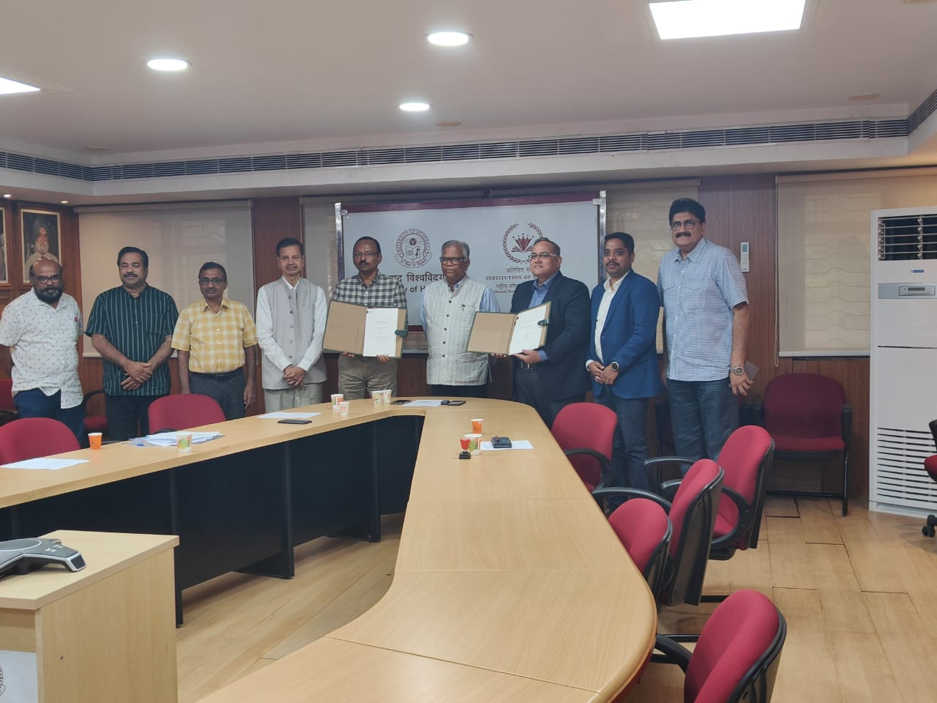

Slide 50
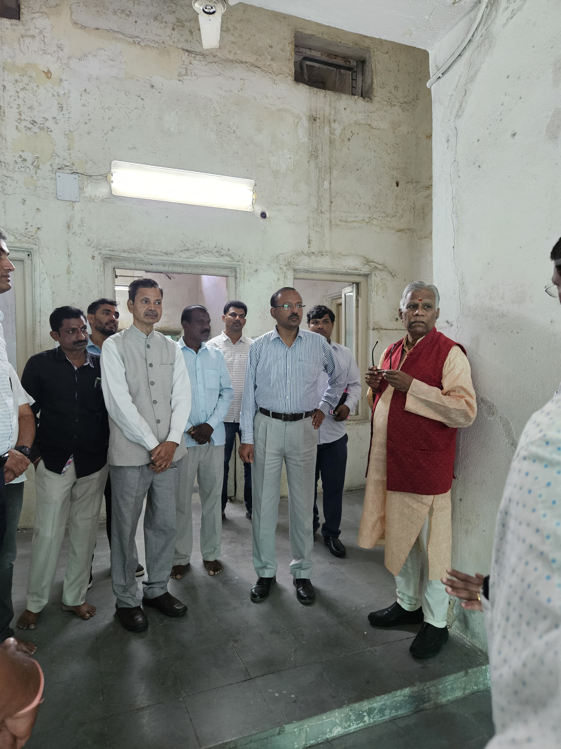
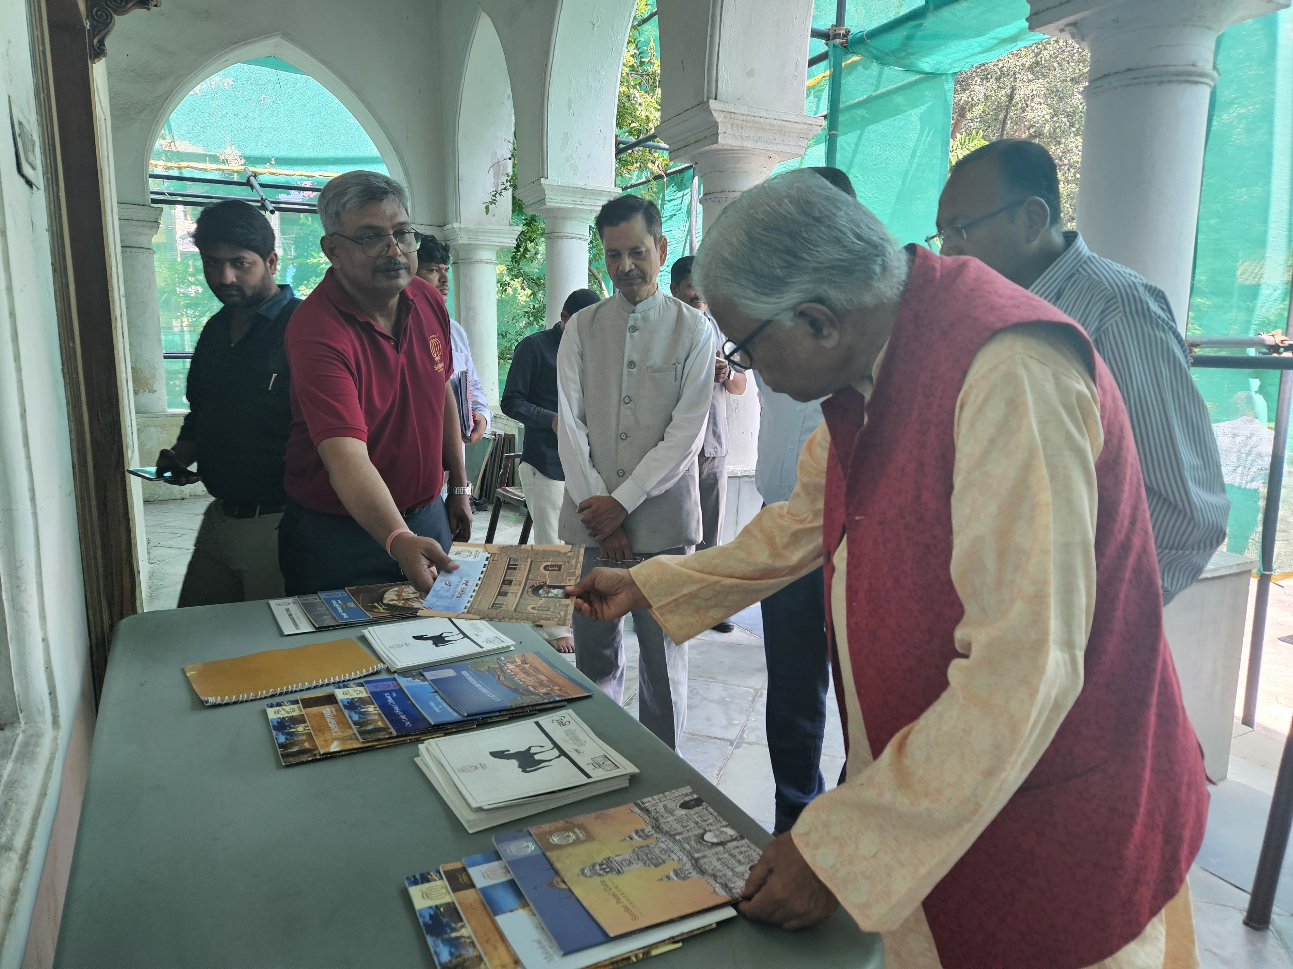

Slide 51
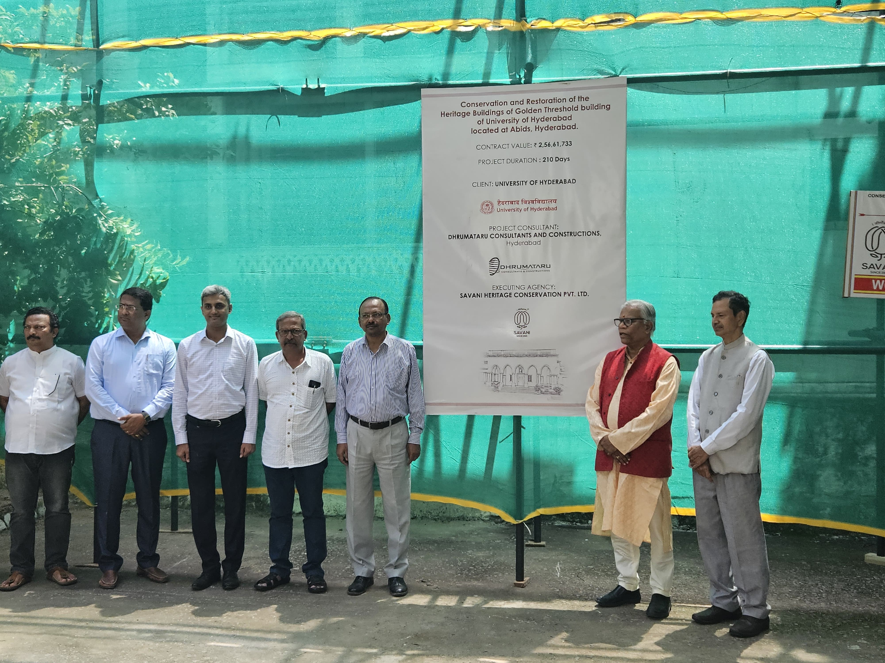

Slide 52
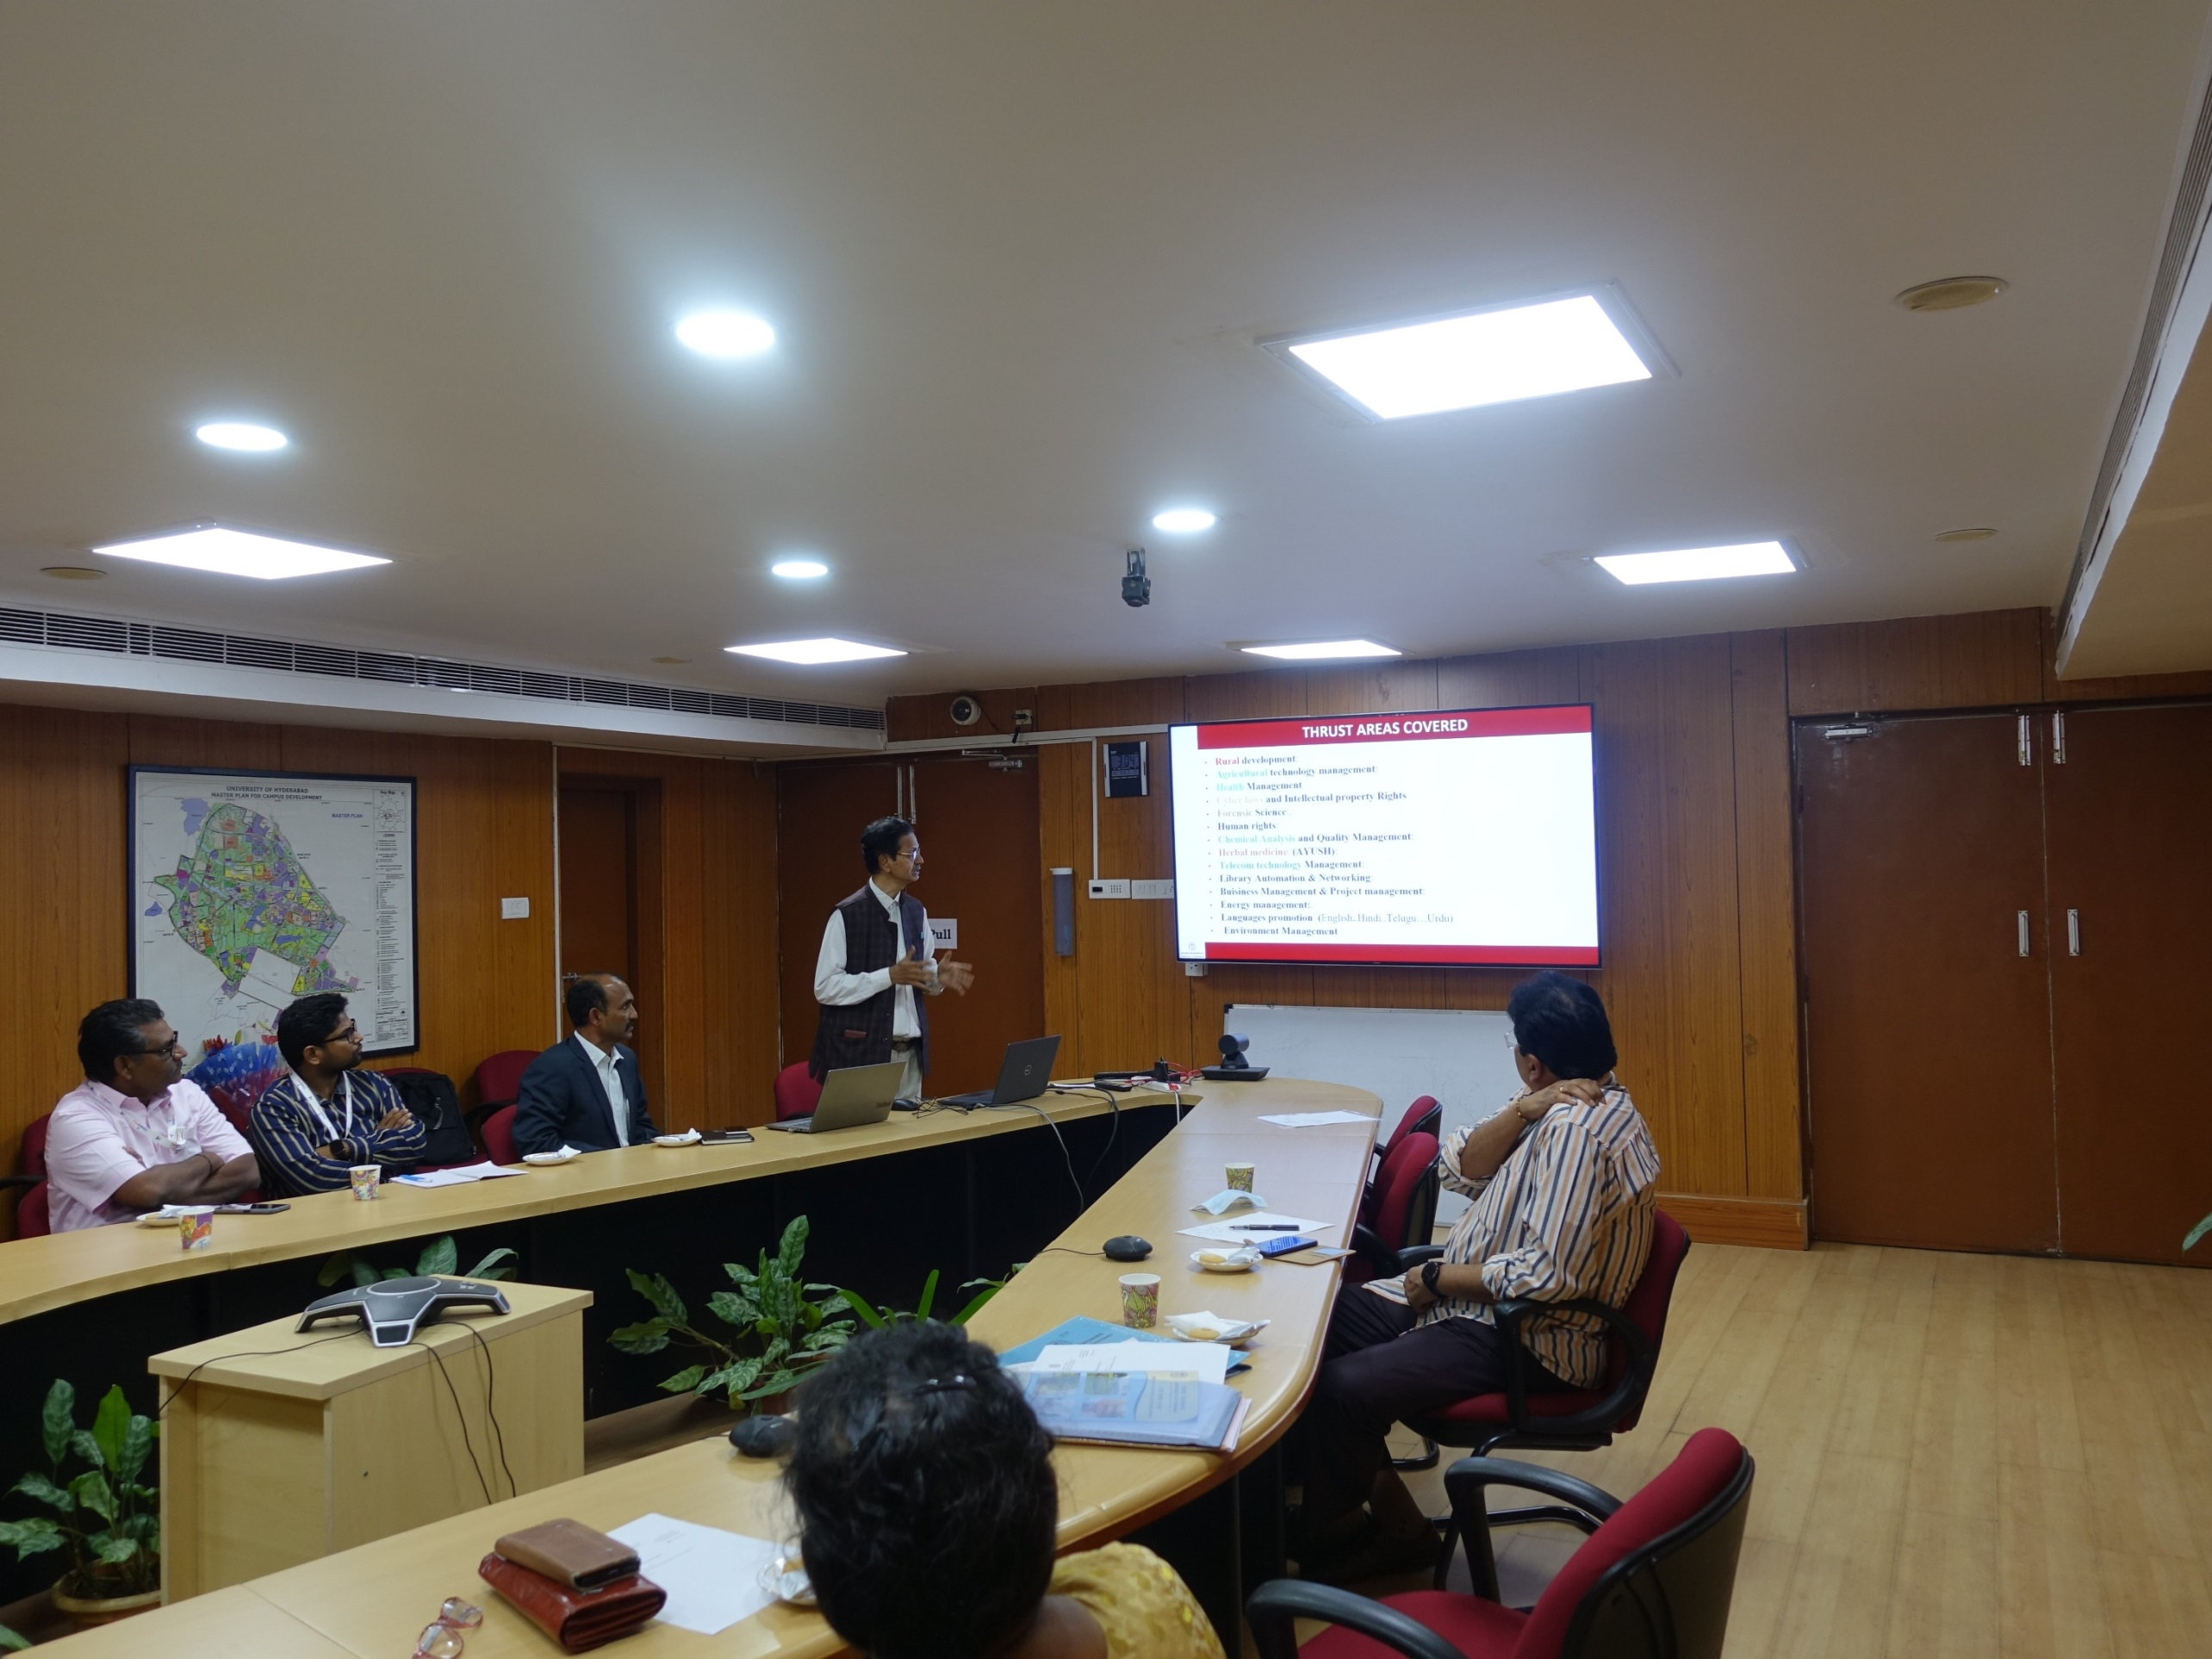

Slide 53
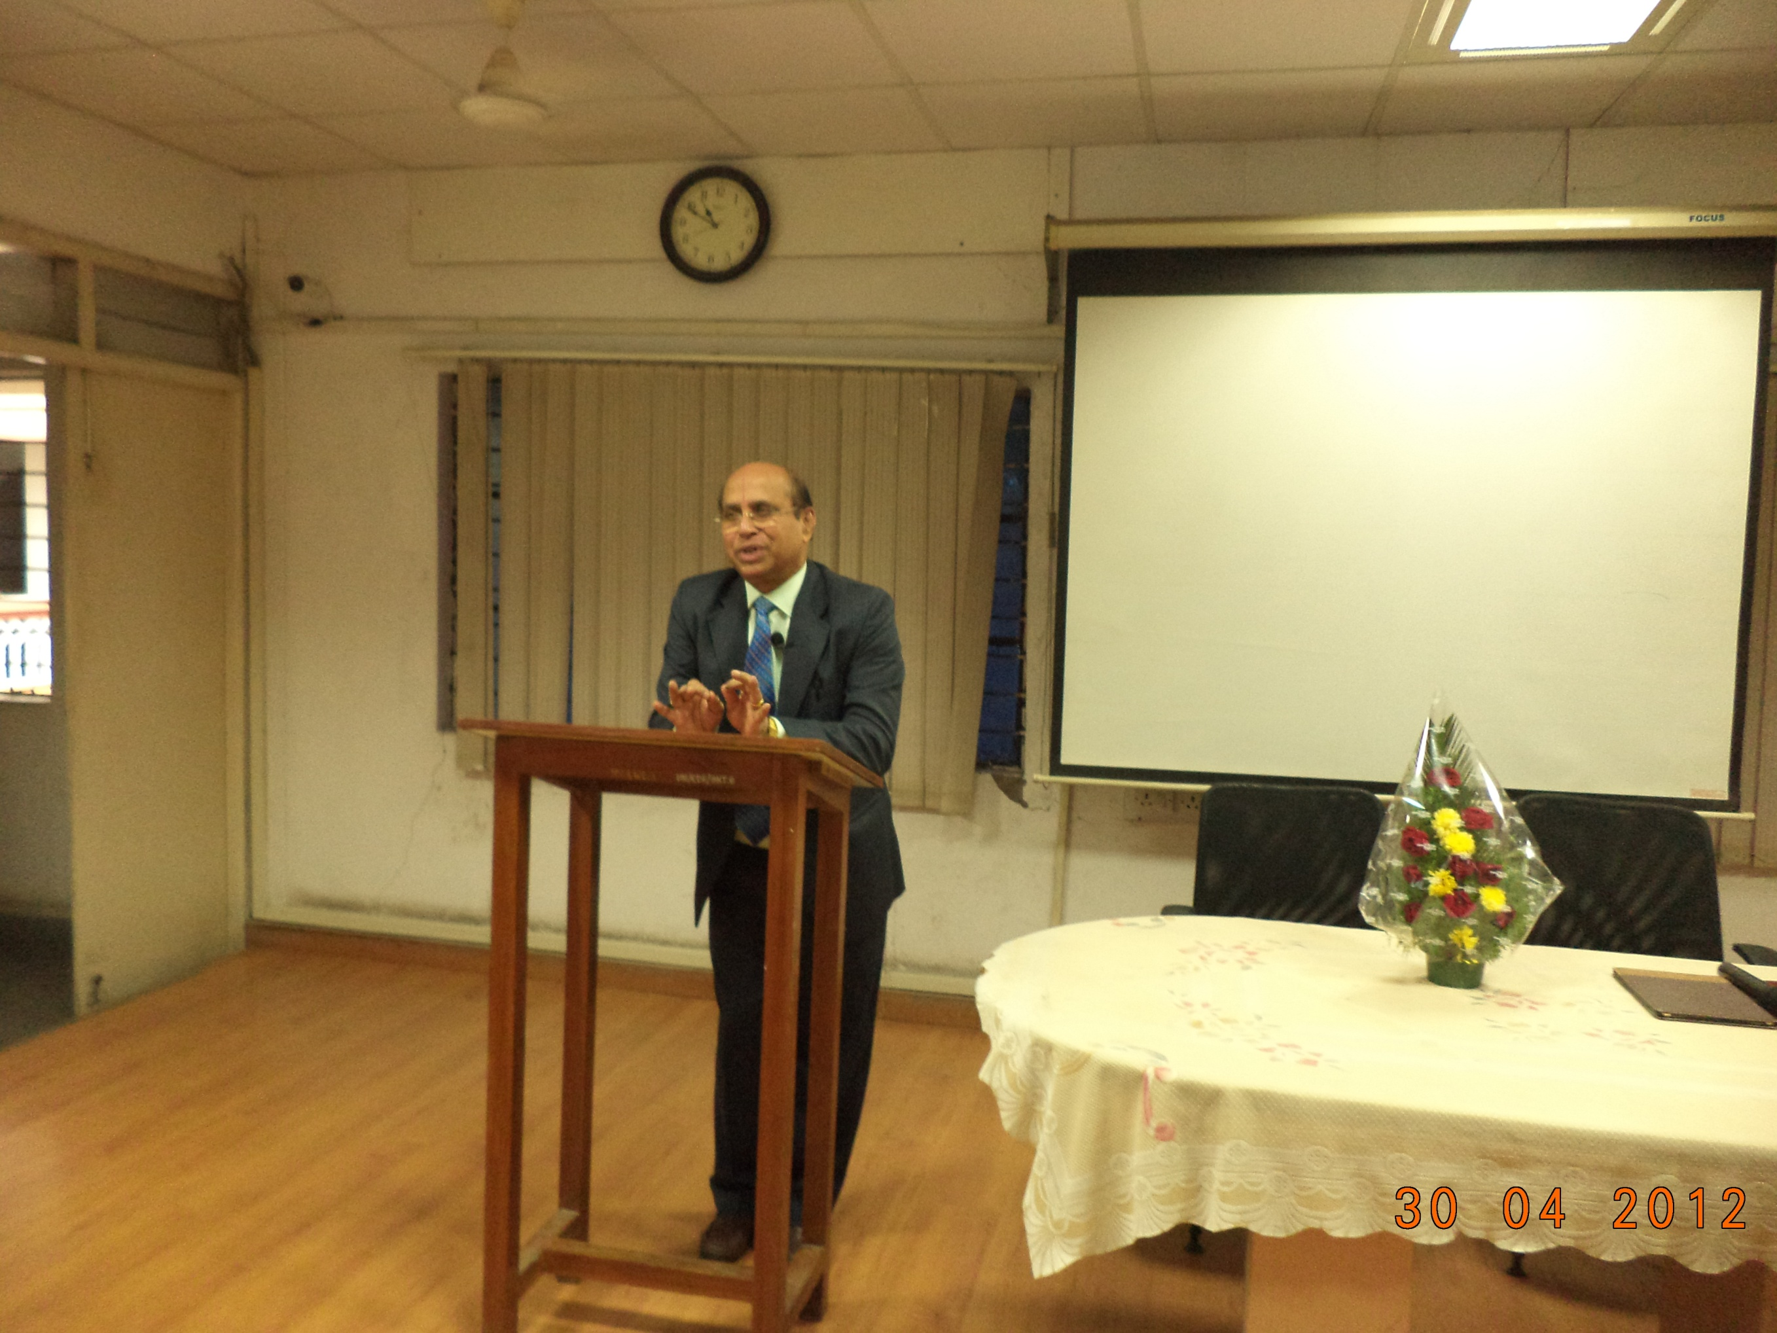
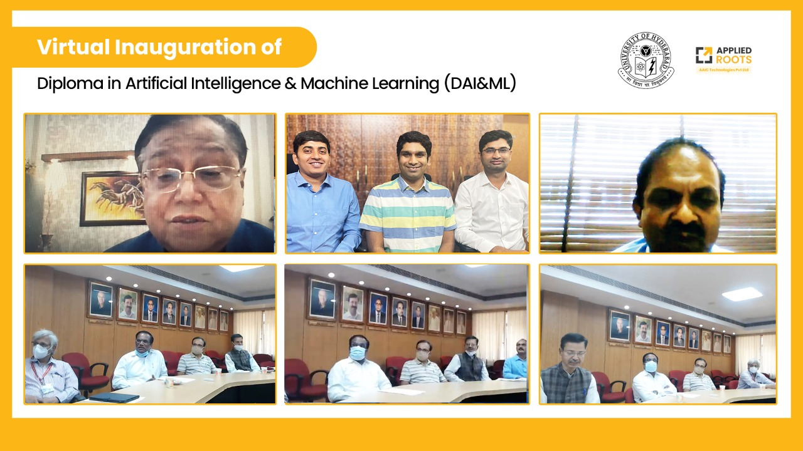
Eminent Persons Lecutres
Justice Yethirajulu & Dr. Saraswat NITI Ayog member

Slide 54
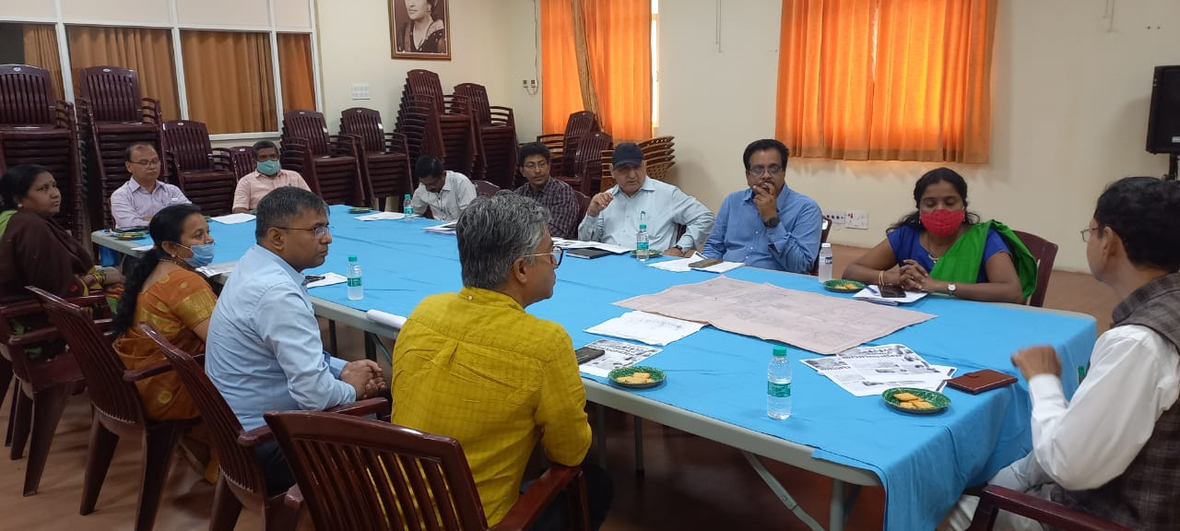

Slide 55
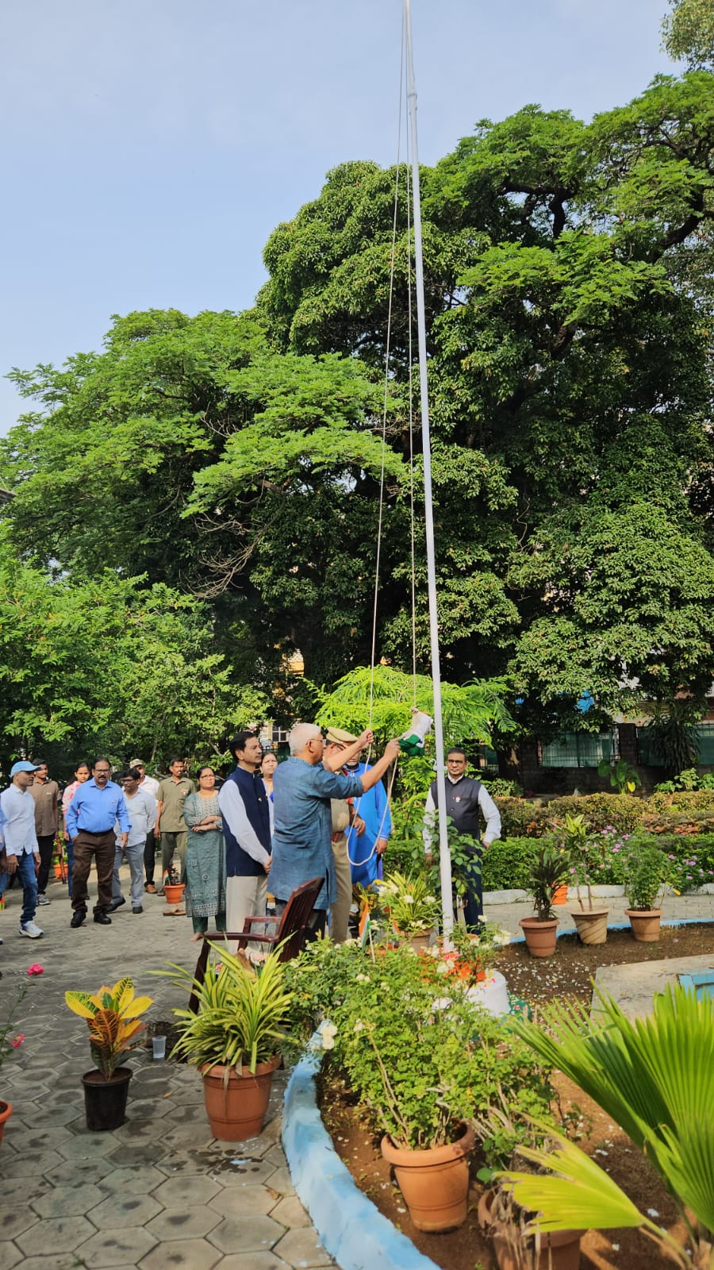
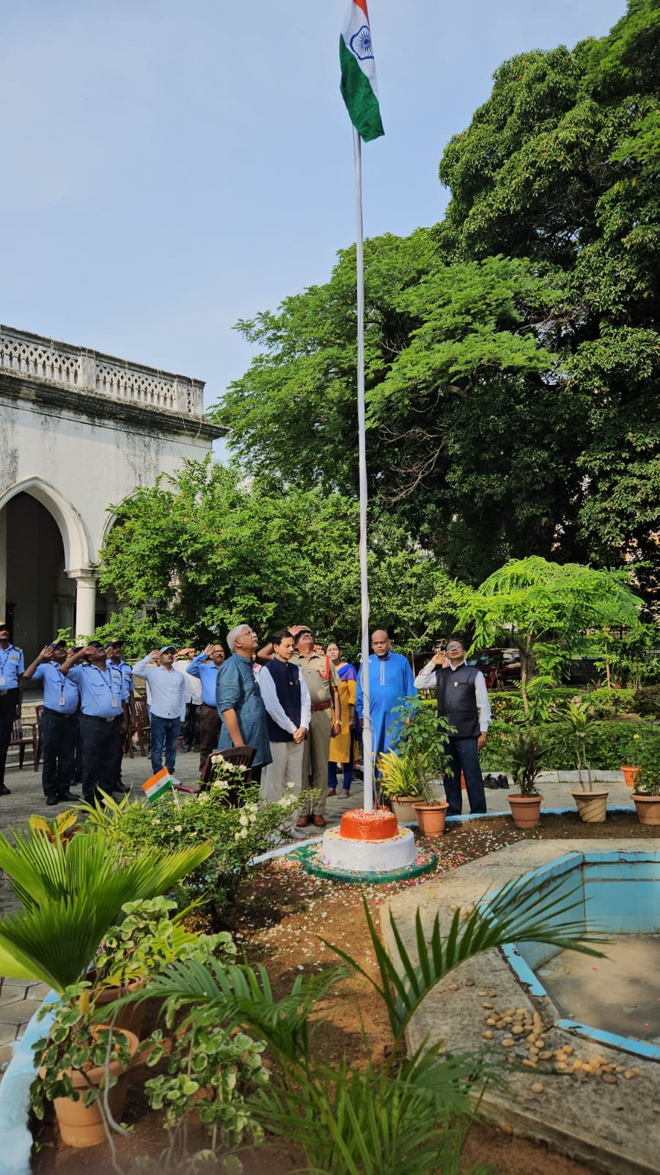

Slide 56
Thank you

